Slide 1

Predictive Performance Analysis of Airbnb Matrix
Emmanuel Osayande Aghedo
Viva Presentation
Department of Computer Science and Creative Technologies
Faculty of Environment and Technology
University of the West of England
Student ID: 23016468

Slide 2
Introduction: Airbnb is an online platform that allows people to rent out their homes, apartments, or other properties to travellers looking for short-term accommodations.
Aim: Develop an integrated, data-driven framework to derive value from Airbnb data.
Introduction / Project Objectives.
Objective 1: Prediction Model
Develop a predictive model to predict optimal listings price and identify influential attributes.
Objective 2: Sentiment analysis
Analyze guest reviews and satisfaction to quantify relationship with performance trends.
Objective 3: Recommender system
Implement collaborative filtering for optimized guest discovery based on listings traits.
Objective 4: Actionable insights
Synthesises output into an interactive tool.

Slide 3
Motivation / Project Rational.
Problem
Solution
The Goal
Host: Limited pricing tools; rely on social learning (Xie et al., 2010)
Guests: Quality assessment difficulty & info overload (Mishara, 2021)
Predictive modelling: Actionable price predictions to optimize host revenue.
Recommender System: Personalised filtering to simplify the guest journey.
Prior studies treat price prediction and recommendation systems as independent silos (Xie et al., 2010; Mishara, 2021).
To develop a unified analytical framework that integrates these systems for a holistic marketplace experience.

Slide 4
Data Description
Reviews Dataset (reviews.csv)
Contents: Historical guest feedback and timestamps.
Key Features: Reviewer ID, Date, and Comment text.
Source: Inside Airbnb, a mission-driven, grassroots project providing transparent, non-commercial rental data.
Context: Dublin was selected due to its high-density tourism profile and complex real estate market. (BreakingNews.ie 2024 and My Ireland Tour, n.d)
Dataset Scope: The research utilizes two primary relational datasets:
Listings Dataset (listings.csv)
Contents: Detailed attributes of each property.
Key Features: Price, location (coordinates), Host characteristics property type, room type, and review scores.

Slide 5
Methodology & Work Flow
Data split: test_size=0.2, random_state=42
Data Source
(Inside Airbnb)
Merge Listings and Reviews data
Data Preprocessing and Cleaning
EDA
Data Aggregate and Encoding
Predict Price
Model Evaluation
Save Best Model (XGBoost)
Guest Feedback
Sentiment Analysis (Vader)
Collaborative Filtering
Model Evaluation
Save Best Model (BaselineOnly)

Slide 6
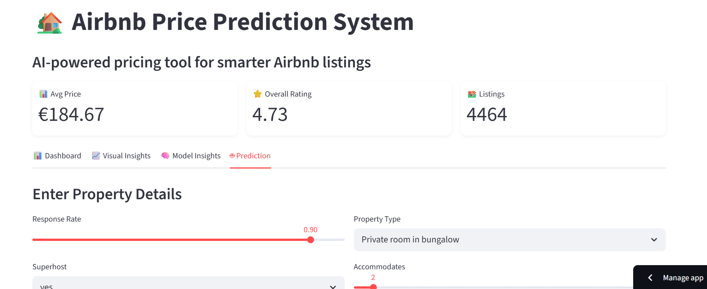
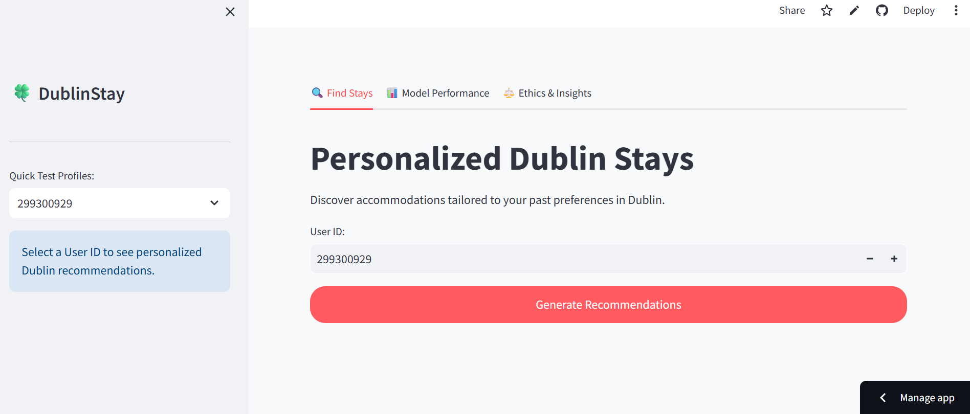
Interactive Dashboard (Artefact)
Price Prediction
https://predictiveperformanceanalysisofairbnbmetrics-4asnlpyjsjc42588x.streamlit.app/
Click on the image below
Recommendation System
https://predictiveperformanceanalysisofairbnbmetrics-8bysfmucc3l2hpevc.streamlit.app
Click in the imaje below

Slide 7
Benefits / Limitation
Benefits of price prediction
Revenue Optimization
Market Alignment
Real time decision support
Interpretability
Benefits of Recommendation system
Personalization
Reduced search time
Better Decision making
Business impact
Limitations of Price
Lack of external factors
Potential bias in historical data
The model may not generalize well outside dublin
These could be addressed in future work with richer data sets
Limitations of Recommendation system
Cold start problems for new users
Dependance on historical interaction data
Lack of contextual factors like time or intent
These could be improved by introducing hybrid recommendation approaches.

Slide 8
Future Work / Tech Stack
Future Work
implement deep learning approaches (e.g., neural collaborative filtering)
Expand analysis to multiple cities.
Incorporate real-time dynamic pricing
Develop hybrid recommendation systems
Tech Stack
Python (Pandas, NumPy, Scikit-learn)
XGBoost
Surprise Library
NLP (Sentiment Analysis)
Streamlit

Slide 9
Reference
Xie, K., Mao, Z abd Wu, J. (2019) ‘Learning from peers: The effect of sales history disclosure on peer-to-peer short-term rental purposes’, internationaljournal of Hospitality Management. [Online]. 76 (Part A), pp. 173-183. Available from: https://doi.org/10.1016/j.ijhm.2018.05.007
Mishta, M., 2021. Airbnb recommendation system using aspect-based sentiment analysis: hybrid approach. MSc. Tilburg University, School of Humanities and Digital Sciences, Department of Cognitive Science & Artificial Intelligence. Available at: https://arno.uvt.nl/show.cgi?fid=161302
BreakingNew.ie (2024) Almost 6.5m nights spent in Airbnb-style accommiodation in Ireland in 2023. Available form: https://www.breakingnews.ie/ireland/almost-6-5m-nights-spent-in-airbnb-style-accommodation-in-ireland-in-2023-1658162.html
My Ireland Tour. (n.d). Dublin Travle Guide, Available from https://www.myirelandtour.com/travelguide/dublin/index.php [Accessed 19 July 2025].

Slide 10
Any questions?

Slide 11
Thank you!
aghedoemmanuel67@yahoo.com

